Slide 1


Great Lakes Indian Fish and Wildlife Commission
GLIFWC
Presented by Hannah Arbuckle, Outreach Coordinator

Slide 2
What is GLIFWC?
Formed in 1984 GLIFWC represents 11 Ojibwe tribes in Minnesota, Wisconsin, Michigan.
These tribes reserved hunting, fishing, and gathering rights in the 1836, 1837, 1842, and 1854 Treaties with the United States government.
GLIFWC is charged with assisting tribes to implement their treaty rights.

Slide 3
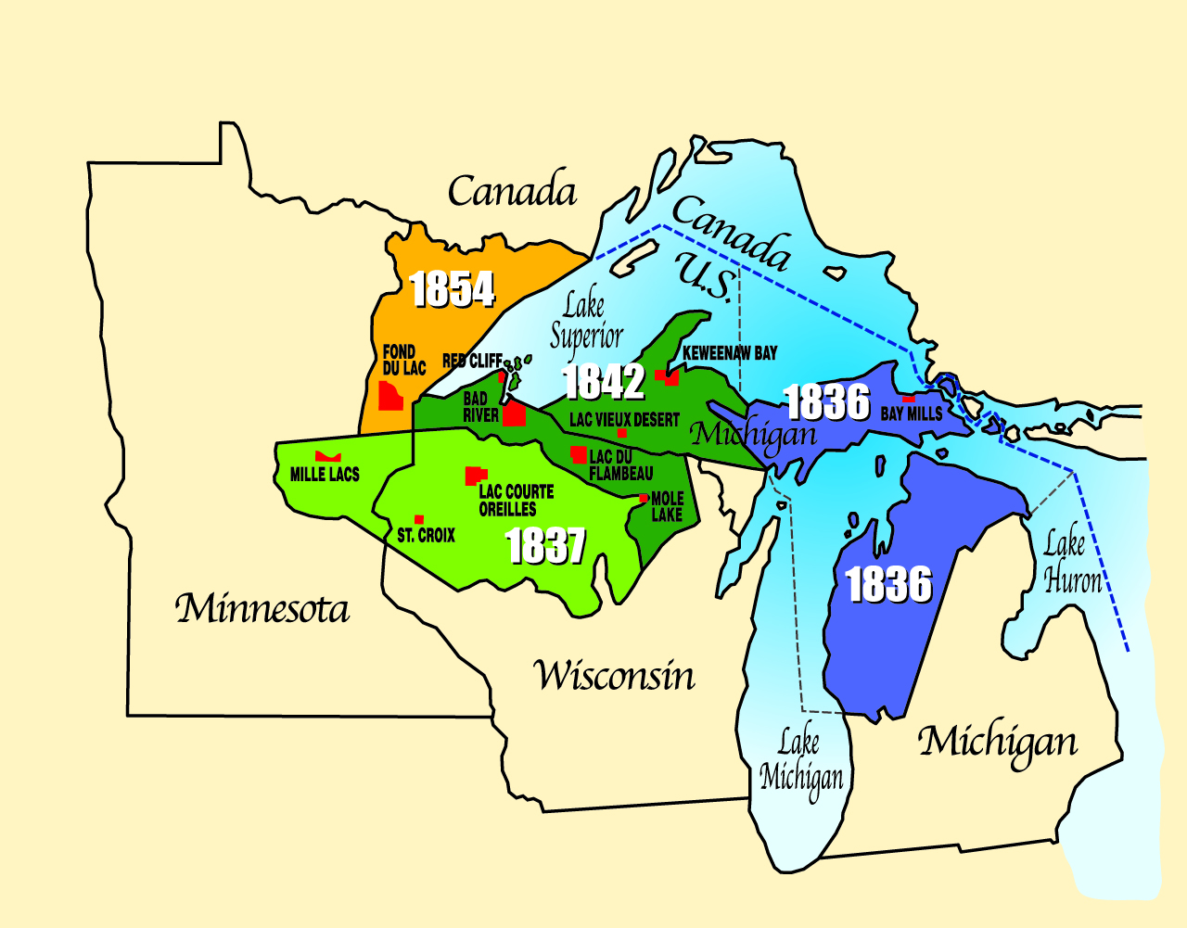
GLIFWC member tribes
Bay Mills (1836 Treaty)
Lac Courte Oreilles (1837 Treaty)
St. Croix (1837 Treaty)
Mille Lacs (1837 Treaty)
Mole Lake (1837 Treaty)
Keweenaw Bay (1842 Treaty)
Lac Vieux Desert (1842 Treaty)
Bad River (1842 Treaty)
Lac Du Flambeau (1842 Treaty)
Red Cliff (1842 Treaty)
Fond Du Lac (1854 Treaty)

Slide 4
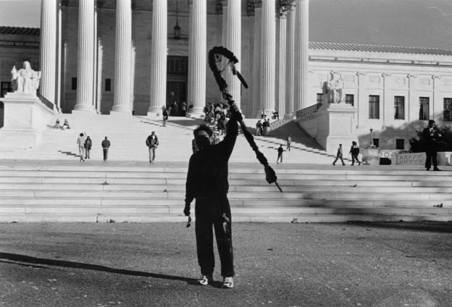
GLIFWC & LCO (Voigt) Decision
1983 Lac Courte Oreilles v. Lester B. Voigt decision affirms treaty rights.
Voigt Intertribal Task Force (VITF) formed in 1983 to implement treaty rights.
VITF merges with Great Lakes Indian Fisheries Commission (1982) to form GLIFWC.

Slide 5
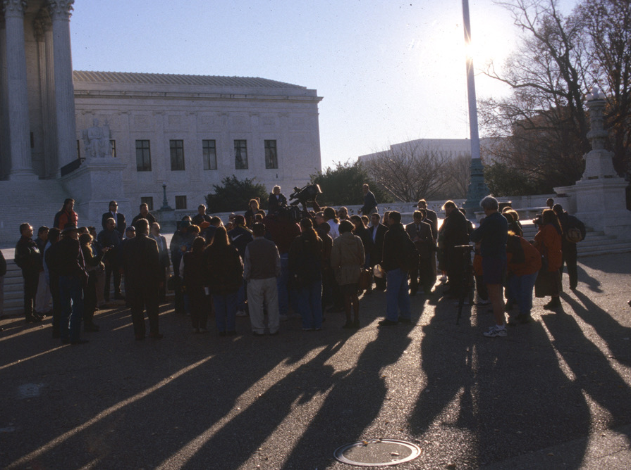
GLIFWC Board of Commissioners
Board of Commissioners (BOC) decides GLIFWC policy.
Board is comprised of tribal chairperson or designee from each member tribe.
Voigt Intertribal Task Force and the Great Lakes Fisheries Committee advise the BOC.

Slide 6
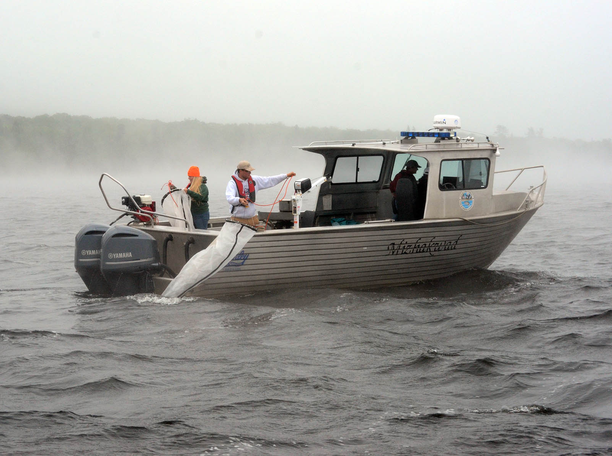
What we do…
GLIFWC in support of the exercise of treaty rights provides:
Resource management expertise
Conservation enforcement
Legal and policy analysis
Public information services
Planning & development

Slide 7
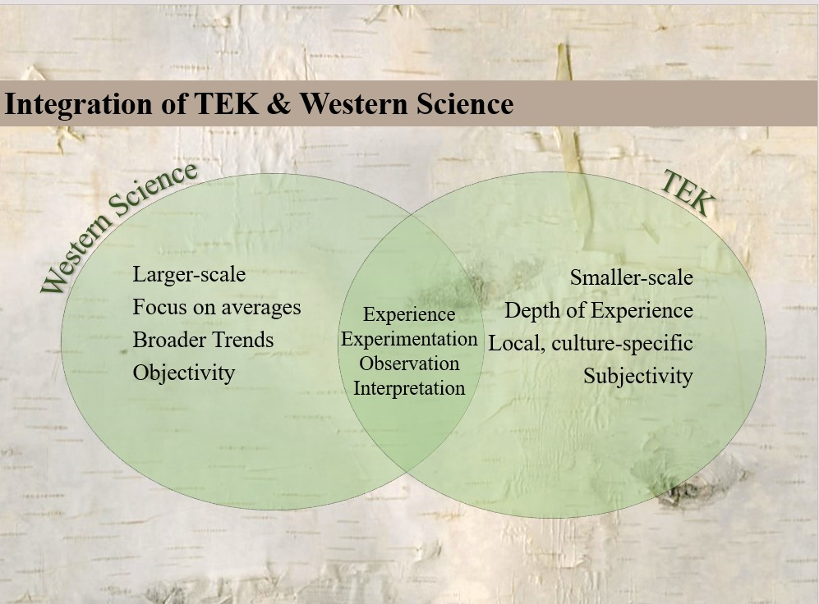
Methods of thinking

Slide 8
Words to understand
Treaty- Formal agreement between two or more sovereign entities (recognized as the supreme law of the land)
Sovereignty- The right to self regulate or develop a self-governing system
Ceded territory- The specific lands or territories given up in exchange for goods, money and reserved rights
Anishinaabe- roughly translates to “Original man.” Refers to Ojibwe, Odawa bands of Indigenous people

Slide 9
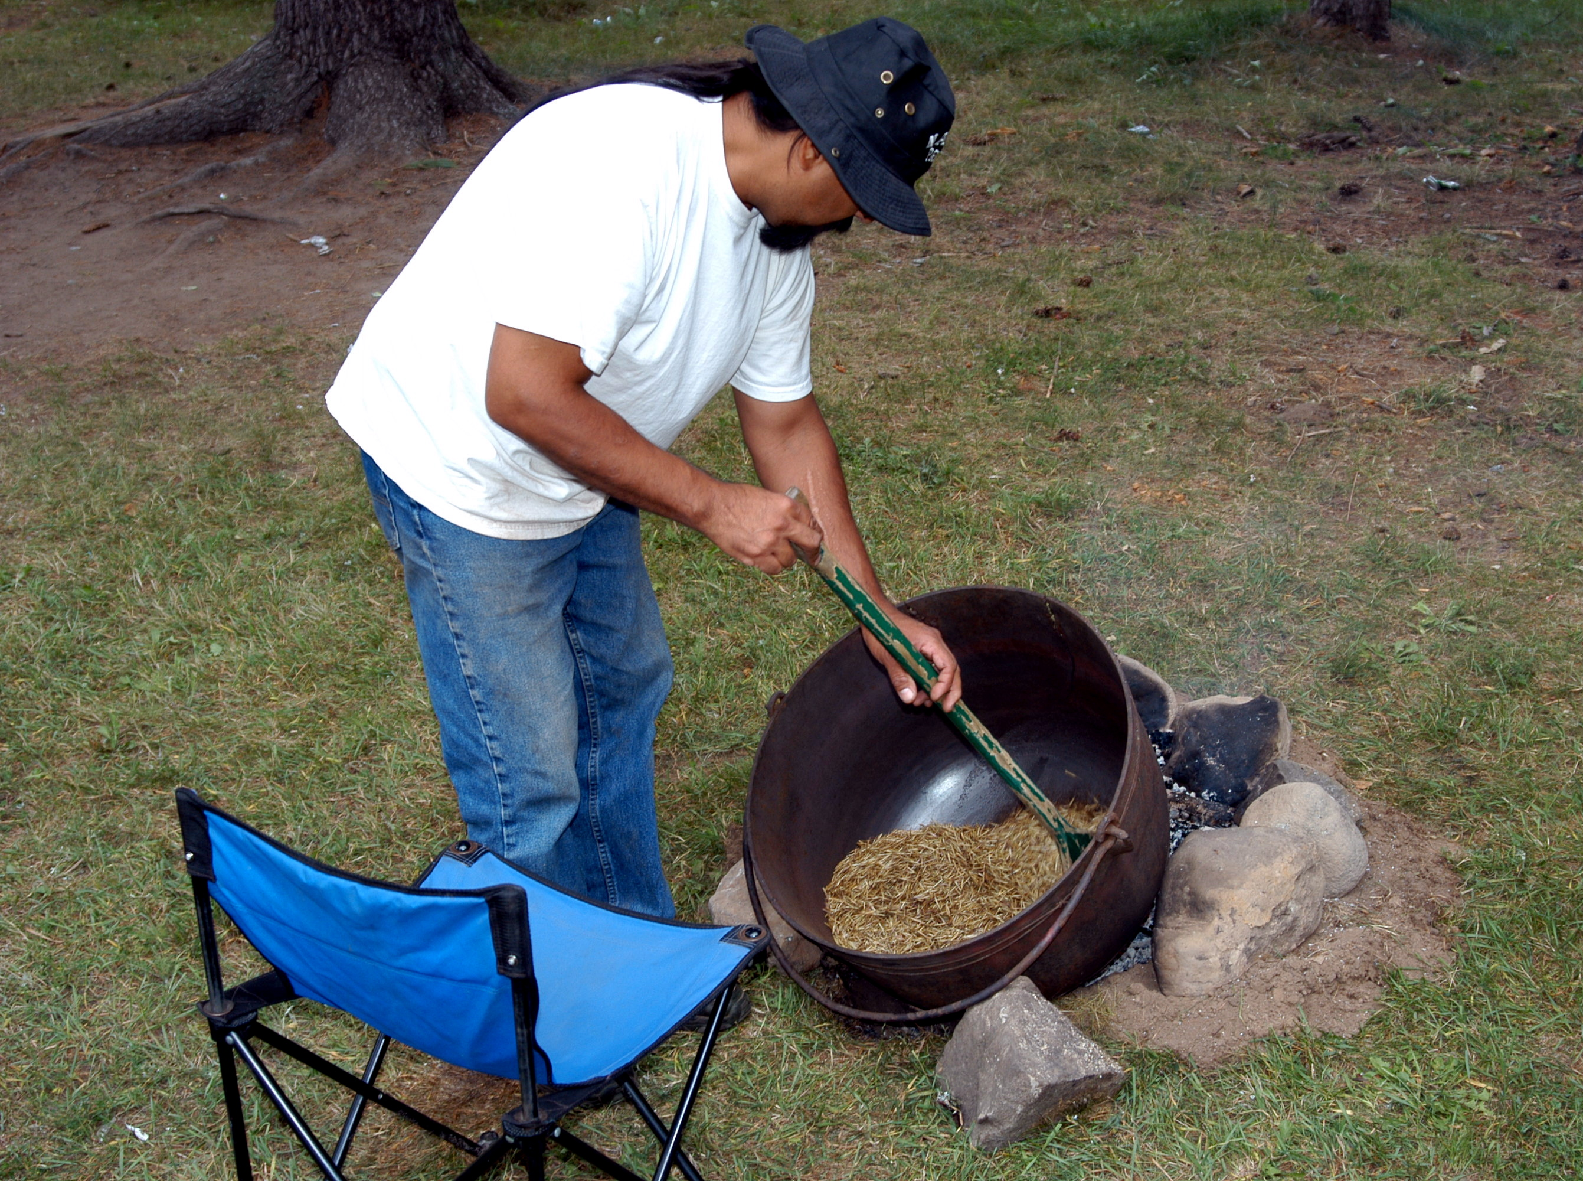
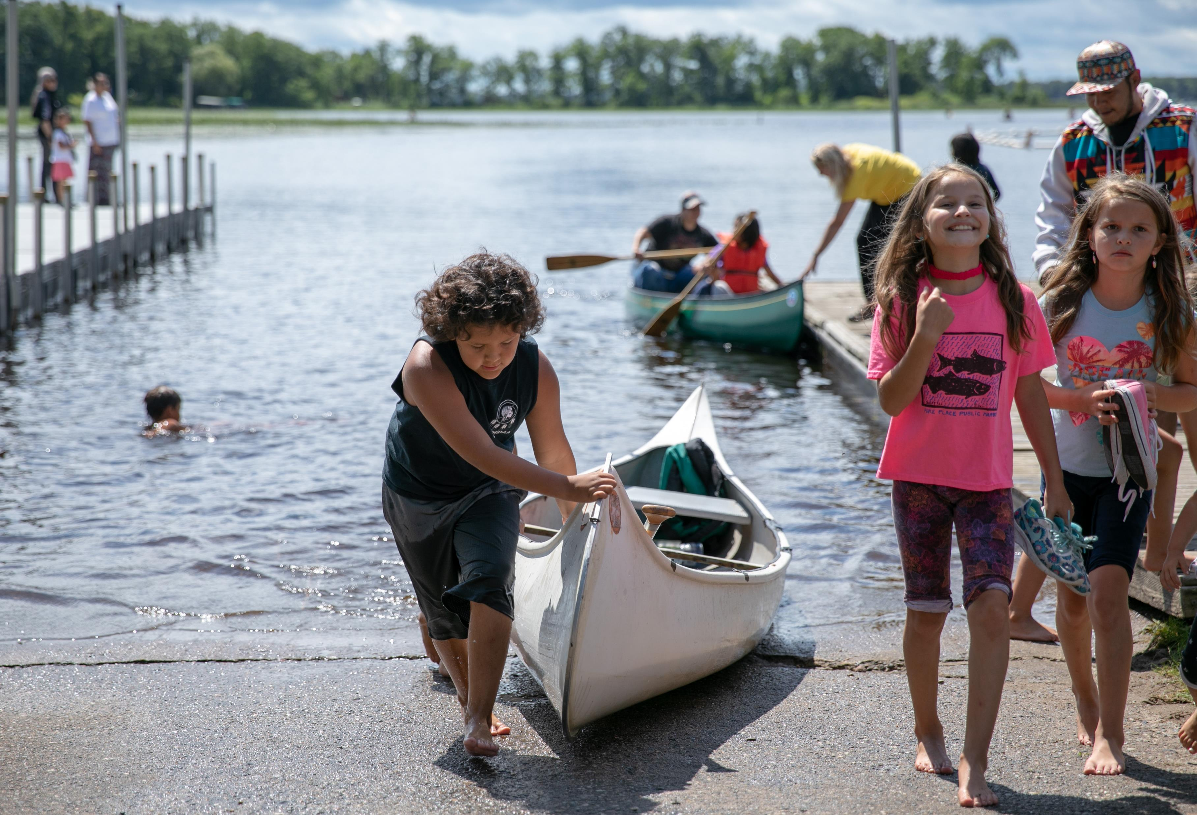
More than a tribal DNR…

Slide 10
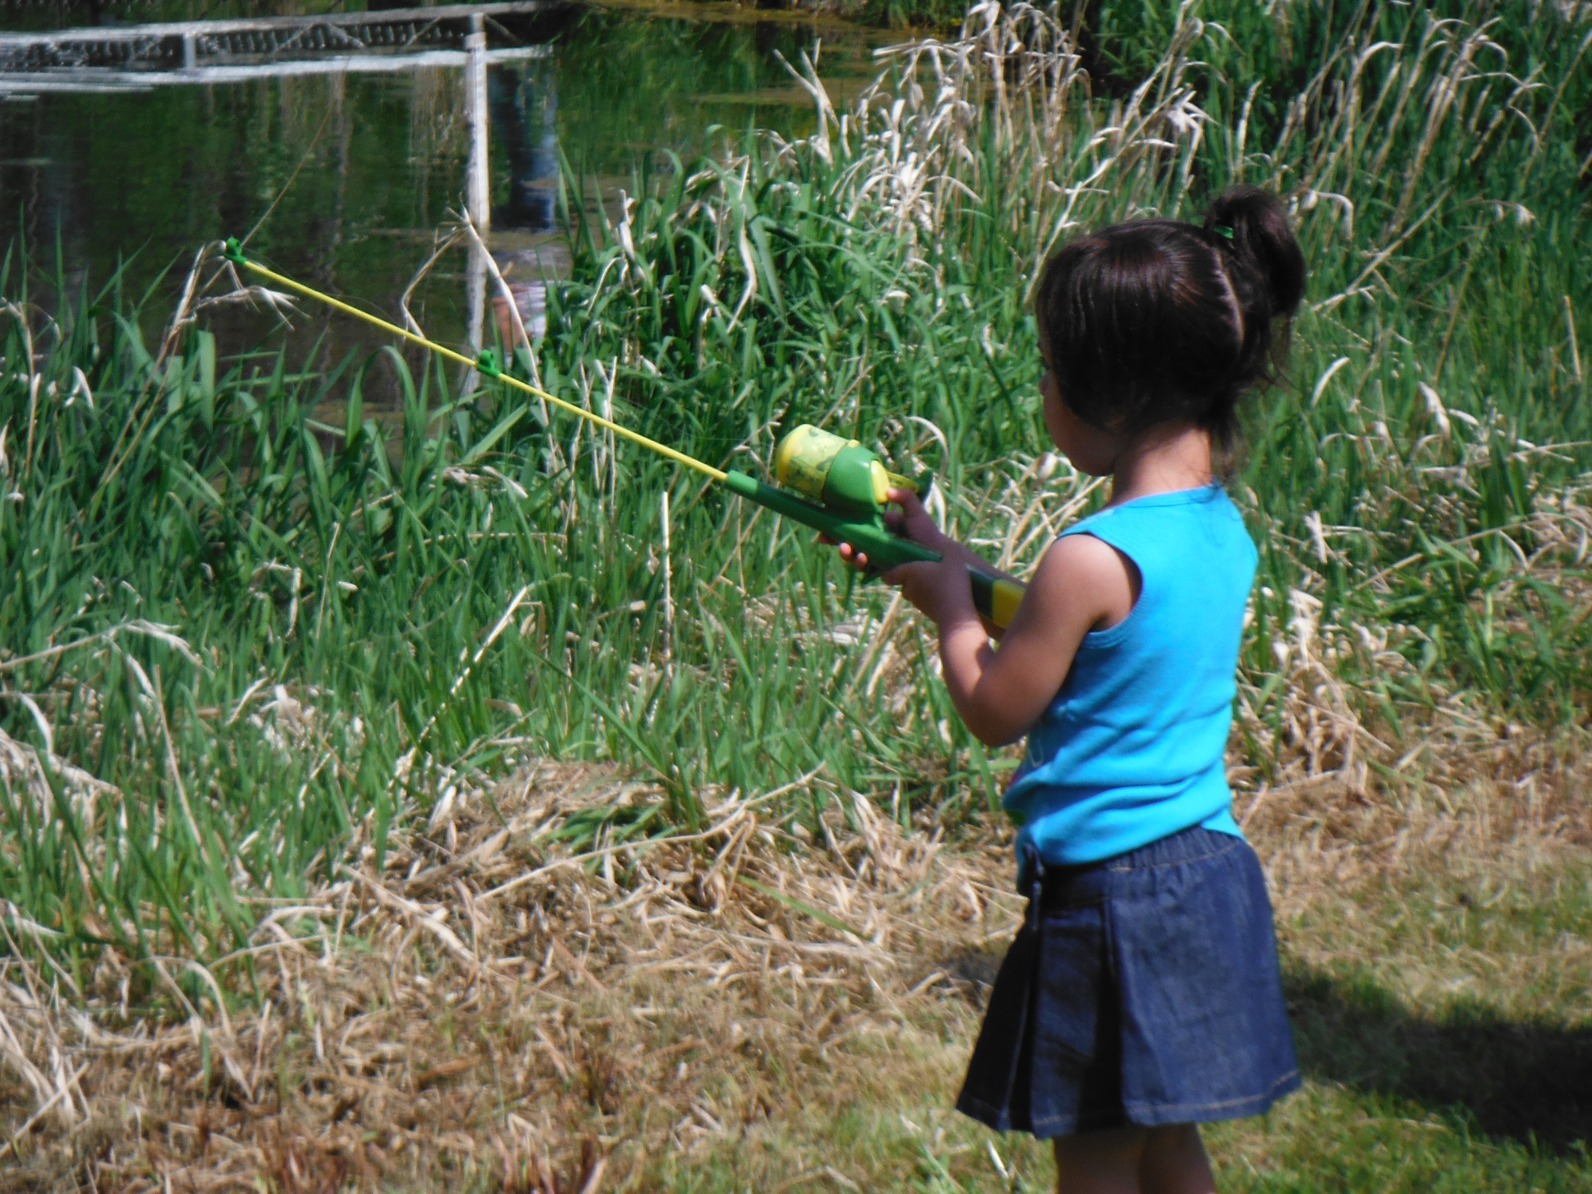
An organization dedicated to cultural and spiritual revitalization…

Slide 11
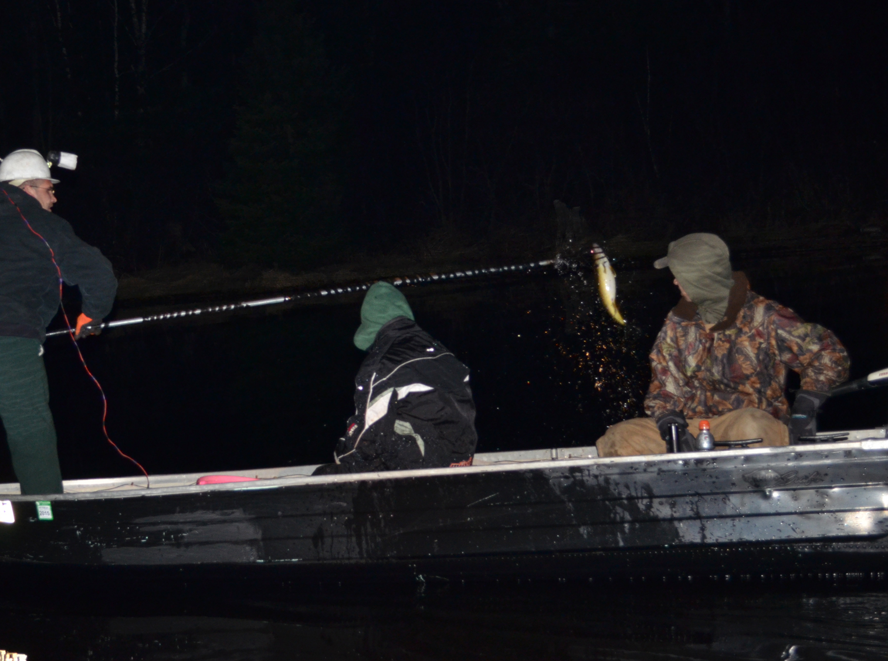
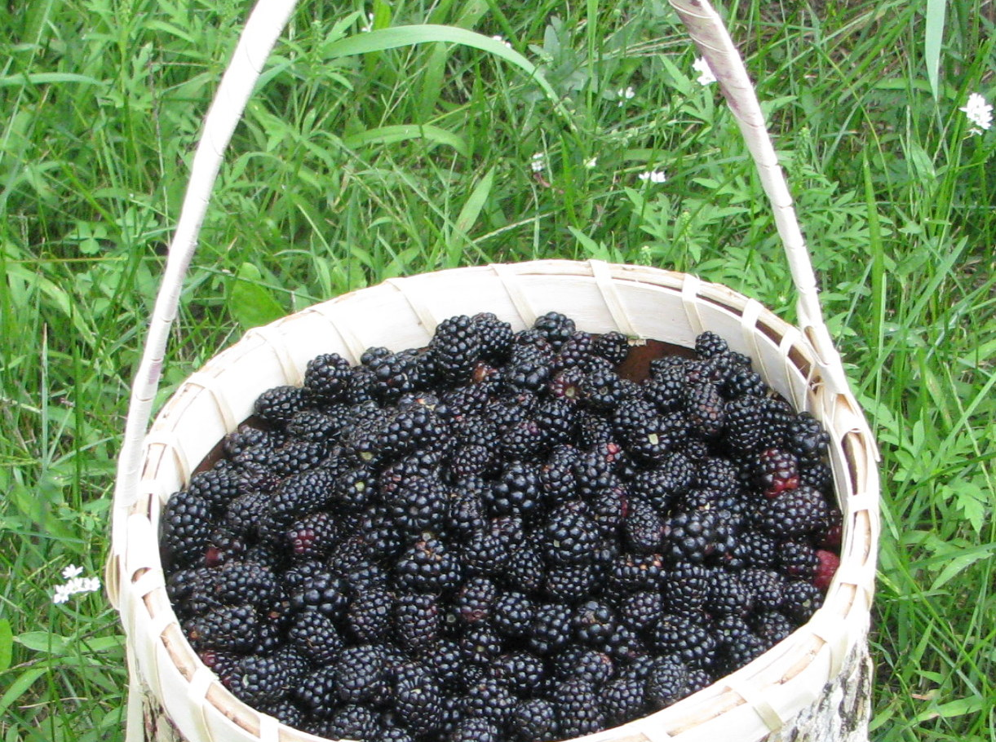
Dedicated to the protection of all creation for future generations…

Slide 12
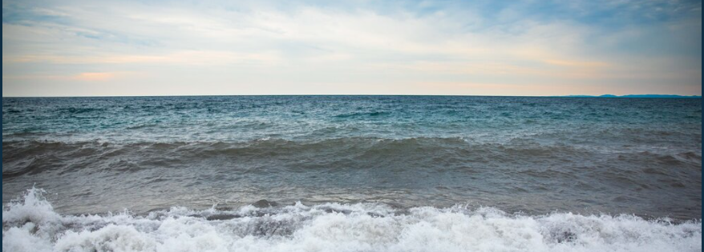
Miigwech to the ancestors that paved the way and reserved these rights…

