Slide 1
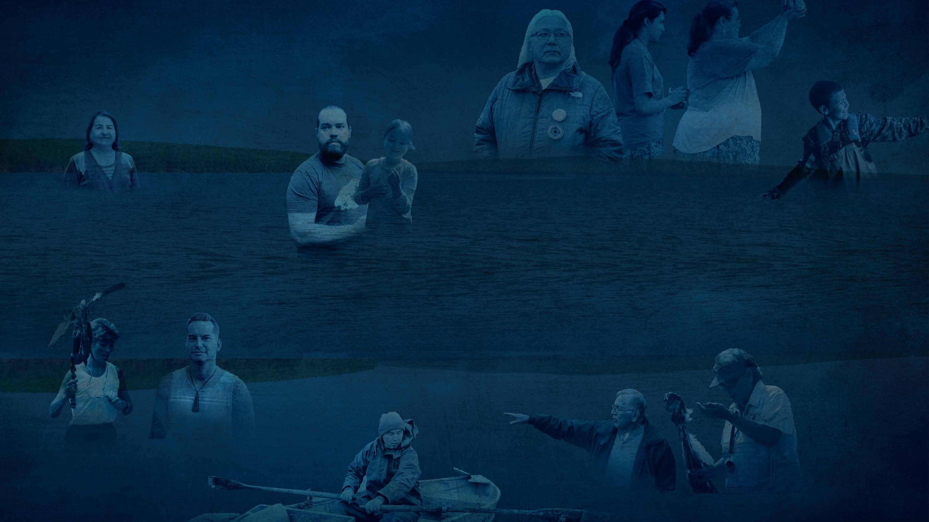
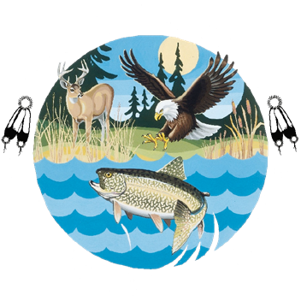
TIMELINE OF ANISHINAABE
TREATY RIGHTS
IN THE NORTHERN GREAT LAKES

Slide 2
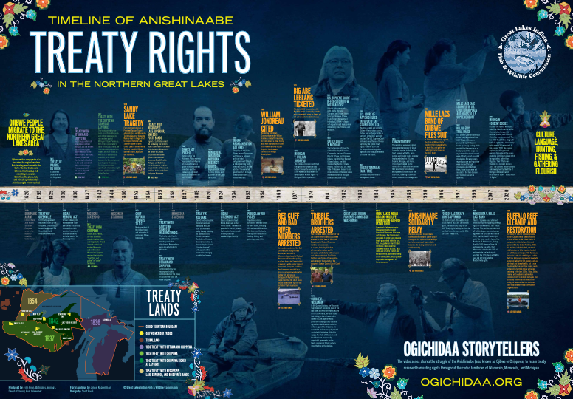
Notes:
Order a free treaty timeline poster: https://glifwc.org/education-outreach/store?search=ogichidaa&category=All

Slide 3






Find the corresponding linked videos on our YouTube channel and the discussion guide for videos in our educational materials store front. Miigwech!
 | glifwc.org |  | Stay up to date
 | 73682 Maple St. Odanah, WI 54861 (715)-682-6619 |  | Follow us on Facebook & Instagram
 | Get the timeline poster and discussion booklet |  | Ogichidaa Playlist on YouTube

Slide 4
OJIB W E P E O P L E M IG R A T E T O T H E NORTHERN GREAT LAKES REGION
Ojibwe creation story speaks of a time when the original people or Anishinaabeg were lowered to the Earth. The first treaties are between Anishinaabeg and everything in creation. Out of love, the plants, fish, and animals agree to sustain Anishinaabeg to ensure survival.

Slide 5
Etienne Brule, Jean Nicolet and other Europeans arrive in the region to establish trade relations.
1620S
EUROPEANS ARRIVE

Slide 6
1795
TREATY OF GREENVILLE
First treaty signed with the United States by the Chippewa. Establishes boundaries between the United States and several Native Nations

Slide 7
Established boundaries of the Chippewa.
1825
TREATY OF PRAIRIE DU CHIEN

Slide 8
1830
INDIAN REMOVAL ACT
Official federal policy whereby entire Tribes are coerced and forcibly removed from their ancestral homelands to unfamiliar Ceded Territories west of the Mississippi River.

Slide 9
1836
TREATY WITH OTTAWA AND CHIPPEWA
Ceded large portions of what is now northern Michigan and the eastern portion of Michigan’s Upper Peninsula to the United States. The tribes, however, stipulated “for the right of hunting on the lands ceded, with other usual privileges of occupancy, until the land is required for settlement.”

Slide 10
1837
MICHIGAN STATEHOOD TREATY WITH CHIPPEWA
Signed at St. Peters, the first of several cession treaties which sold large tracts of land in north central and eastern Minnesota and northwestern Wisconsin. Chippewa retained their right to “hunt, fish, and gather” in “ceded” territories.

Slide 11
1842
This treaty ceded further lands in northern Wisconsin and in the copper and iron rich western part of Michigan’s Upper Peninsula. With terms comparable to those in the 1837 Treaty, the tribes received payments to traders and half-bloods as well as a 25-year annuity schedule, to be divided between the Mississippi and Lake Superior Chippewa. The Chippewa leaders specifically retained the right to hunt and fish on Ceded Territory.
TREATY WITH THE CHIPPEWA SIGNED AT LAPOINTE

Slide 12
1848
WISCONSIN STATEHOOD

Slide 13


1850
SANDY LAKE TRAGEDY
Four prominent officials of President Zachary Taylor's administration and Minnesota Territorial Governor Alexander Ramsey lead an illegal effort to conspire to move Lake Superior Ojibwe to lands (Sandy Lake) in the Minnesota Territory. Over 400 Ojibwe die from illness, exposure, and starvation.
Notes:
https://www.youtube.com/watch?v=JLig6Pv1b7Y&list=PLFXNmBtWd9iF2ppvNFJ5_WNRmiyFDK5Nu&index=6

Slide 14
Meets president of the United States and advocates for permanent Ojibwe homelands.
1852
CHIEF BUFFALO TRAVELS TO D.C.

Slide 15
1854
Signed at La Pointe, ceded the land along the western side of Lake Superior between Fond du Lac in Minnesota to the border of Canada.
Established permanent Ojibwe reservations at Keweenaw Bay (L'Anse) in Michigan and Bad River, Lac du Flambeau, and Lac Courte Oreilles in Wisconsin, and Fond du Lac and Grand Portage in Minnesota.
TREATY WITH MISSISSIPPI, LAKE SUPERIOR, AND BOIS FORTE BANDS

Slide 16
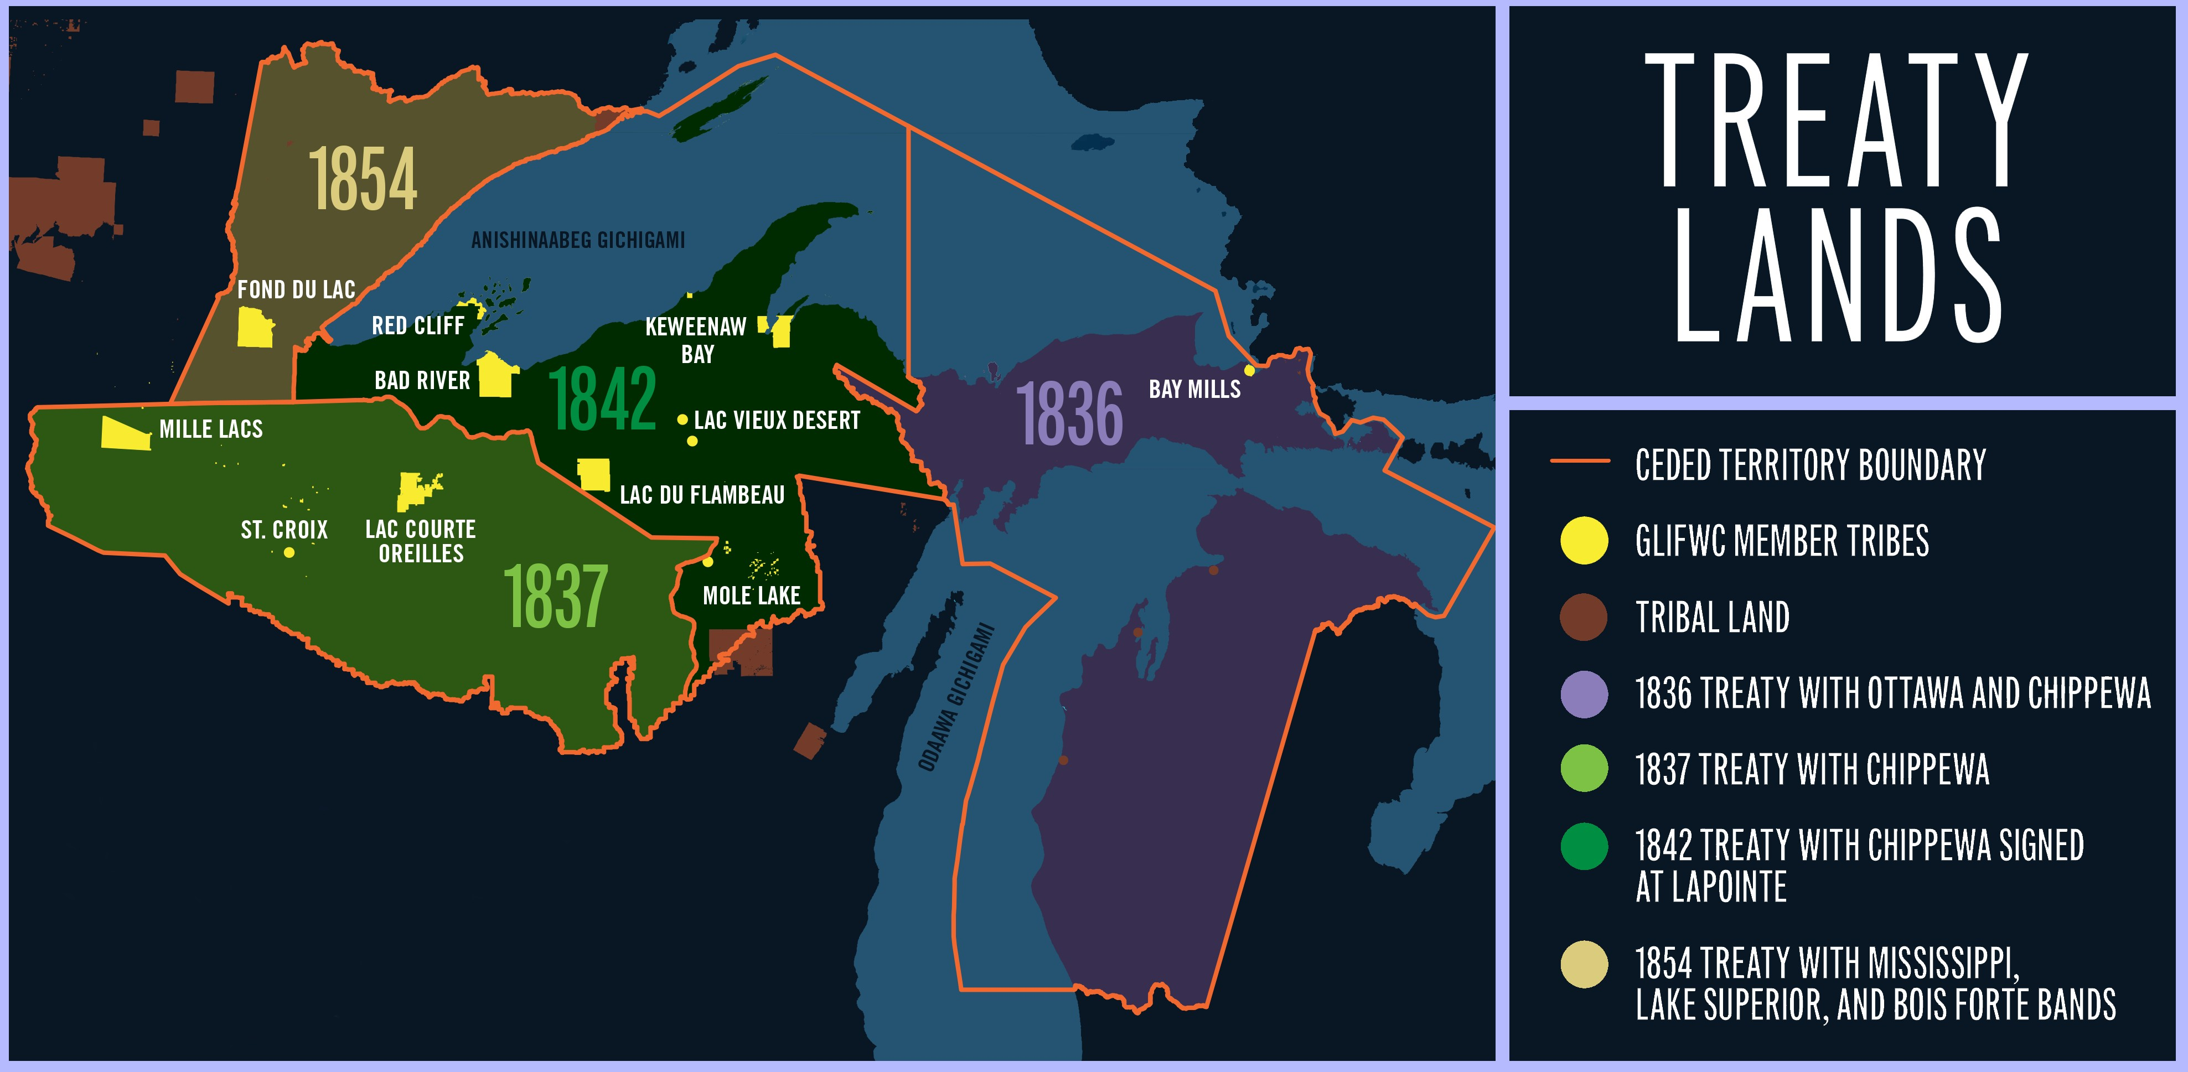

Slide 17
I. The treaty ceded land in the Minnesota Territory for monetary and other stipulations. Reservations were also established in MN.
1855
TREATY WITH CHIPPEWA SIGNED AT WASHINGTON D.C.
TREATY WITH OTTAWA AND CHIPPEWA
II. Established fishing and encampment rights established under the Treaty of 1820 for the Sault Ste. Marie Chippewa.

Slide 18
1858
MINNESOTA STATEHOOD

Slide 19
1887
DAWES ACT PASSED
Set in motion the Allotment Policy whereby approximately 160 acres of reservation land is given to individual tribal members and the remaining millions of acres of tribal lands are sold to non-natives.

Slide 20
1889
TREATY AT RED LAKE
Ceded land surrounding the reservation and exempted Red Lake from the Allotment policy thereby retaining its sole status as a closed reservation.
Red Lake will become the only reservation in the country that is not “checker-boarded” with parcels of the reservation belonging to non-native landowners.

Slide 21
Begin arresting Ojibwe hunters, fishers, and gatherers in the Ceded Territories.
1920S
MINNESOTA, WISCONSIN, MICHIGAN RESTRICT RIGHTS

Slide 22
1924
INDIAN CITIZENSHIP
Grants citizenship to all Native Americans in the United States. There was no provision in the Act, however, that required Indian people to relinquish tribal membership or identity.

Slide 23
1934
INDIAN REORGANIZATION ACT (IRA)
The policy of the United States federal government established a national policy of tribal self-government through a tribal governing body, the tribal council, and the ability of those elected governments to manage the affairs of their respective tribes.

Slide 24
1953
PUBLIC LAW 280 PASSED
Transferred criminal jurisdiction on tribal lands to some states, including Wisconsin and Minnesota.
The states use the law to up their violations of hunting, fishing, and gathering treaty rights.

Slide 25


1954
WILLIAM JONDREAU CITED
Keweenaw Bay Indian Community member William Jondreau cited after returning to shore aboard a small fishing boat with four lake trout taken from Keweenaw Bay in Lake Superior.
Jondreau was convicted in Baraga County Court.
Notes:
https://www.youtube.com/watch?v=q5TmLyWyFM0&list=PLFXNmBtWd9iF2ppvNFJ5_WNRmiyFDK5Nu&index=3

Slide 26

1969
Six enrolled members of the Red Cliff Band, including Richard Gurnoe, are arrested by Wisconsin Department of Natural Resources officers after pulling a gill net from Lake Superior that contained a white sucker.
Around three weeks later, two Bad River Band members are cited by a state conservation warden while fishing with gill nets on Lake Superior. A Bayfield County judge ruled that the 1854 Treaty did not protect their right to fish outside of state regulations.
RED CLIFF AND BAD RIVER MEMBERS ARRESTED
Notes:
https://www.youtube.com/watch?v=ZmcdaUtLU1E&list=PLFXNmBtWd9iF2ppvNFJ5_WNRmiyFDK5Nu&index=4

Slide 27

I. Fishing in 1836 Treaty waters, the Bay Mills Indian Community member was charged with using an illegal gill net and convicted in district court.
1971
BIG ABE LEBLANC TICKETED
MICHIGAN V. WILLIAM JONDREAU
II. The Jondreau Decision reaffirmed the right of the Keweenaw Bay Indian Community members to fish in Keweenaw Bay waters of Lake Superior without regard to Michigan fishing regulations.
Notes:
https://www.youtube.com/watch?v=VBIzPnETBkQ&list=PLFXNmBtWd9iF2ppvNFJ5_WNRmiyFDK5Nu&index=5

Slide 28

1974
TRIBBLE BROTHERS ARRESTED
Fred and Mike Tribble, members of the Lac Courte Oreilles Band (LCO), were arrested on Chief Lake by Wisconsin Department of Natural Resources wardens for possession of a spear, for taking fish from off-reservation waters and for occupying a fish shanty without name and address attached.
The Tribble brothers were fishing off- reservation and were later found guilty of the chargers in Sawyer County Circuit Court.
Notes:
https://www.youtube.com/watch?v=KSpEGhWR44Q&list=PLFXNmBtWd9iF2ppvNFJ5_WNRmiyFDK5Nu&index=1

Slide 29
1974
GURNOE V. WISCONSIN
In the Gurnoe Decision, the Wisconsin Supreme Court decided in favor of the Bad River and Red Cliff Bands. Based on the1854 Treaty, the court found that fishing in the off- reservation waters of Lake Superior was a protected treaty right and that any regulations that the state seeks to enforce against the Chippewa are reasonable and necessary to prevent a substantial depletion of the fish supply.
The State of Wisconsin and tribes have successfully negotiated agreements for the treaty commercial fishing activity since the time of the decision.
Notes:
ICWA passes 1978

Slide 30
1981
Upholds rights reserved in 1836 treaty. Michigan Chippewa and Ottawa tribes form the Chippewa Ottawa Treaty Management Authority (COTFMA) to begin self- regulation and management of the treaty area fisheries and resources.
U.S. SUPREME COURT REFUSES TO REVIEW MICHIGAN CASE
Notes:
Who is CORA?

Slide 31
1981
UNITED STATES V. MICHIGAN
The Fox Decision affirmed the rights of the Bay Mills Indian Community, the Grand Travers Band of Ottawa and Chippewa Indians, the Little River Band of Ottawa Indians, the Little Traverse Bay Bands of Odawa Indians, and the Sault Ste. Marie Tribe of Chippewa Indians to fish in ceded areas of the Great Lakes in the boundaries of Michigan based on the 1836 Treaty.

Slide 32
1982
GREAT LAKES INDIAN FISHERIES COMMISION WAS FORMED

Slide 33
1983
Reverses appeal and upholds Ojibwe off reservation hunting, fishing, and gathering rights as set forth in the 1837 and 1842 treaties.
The U.S. Supreme Court refuses to hear the case thereby upholding the Ojibwe treaty rights. Governor Earl calls for cooperation among state agencies and tribal governments to resolve the matter.
U.S. COURT OF APPEALS RULES IN FAVOR OF LAC COURTE OREILLES

Slide 34
Created to address resource management issues.
1983
VOIGT INTERTRIBAL TASK FORCE ESTABLISHED

Slide 35
1984
Founded by eleven sovereign tribal governments located throughout Minnesota, Wisconsin, and Michigan.
The Commission’s purpose is to protect and enhance treaty-guaranteed rights to hunt, fish, and gather on inland Ceded Territories, ceded under the Chippewa Treaties of 1836, 1837, 1842, and 1854; to protect and enhance treaty-guaranteed fishing on the Great Lakes; and to provide cooperative management of these resources.
GREAT LAKES INDIAN FISH & WILDLIFE COMMISSION (GLIFWC) ESTABLISHED

Slide 36
1985
CONSENT DECREE
The regulatory agreement details management protocols for Great Lakes fish species including lake trout, walleye, whitefish, perch, salmon and bloater chubs, covering treaty-ceded waters of Lakes Superior, Michigan, and Huron.
The compact helped lay the foundation for additional settlements that would keep the state and Michigan treaty tribes out of the courtroom, ushering in an era of natural resources co- management.

Slide 37

1989
ANISHINAABE SOLIDARITY RELAY
Begins in response to racism and hatred directed towards Ojibwe people throughout the region at boat landings and other communal spaces.
Later becomes the Healing Circle Run and continues today.
Notes:
https://www.youtube.com/watch?v=zn-DM2SQW8M&list=PLFXNmBtWd9iF2ppvNFJ5_WNRmiyFDK5Nu&index=2
ACT 31 passes in Wisconsin (1989)

Slide 38
1996
U.S. District Court affirmed the Fond du Lac Band’s 1837 and 1854 Treaty rights.
The nature and scope of the 1837 Treaty rights held by the Fond du Lac Band were the same as the Mille Lacs 1837 Treaty rights.
FOND DU LAC TREATY RIGHTS AFFIRMED

Slide 39
I. Heads to Supreme Court.
1997
MILLE LACS CASE IF UPHELD IN U.S. COURT OF APPEALS
RULING ENDS TRIAL PHASE
II. U.S. District Court ended the trial portion of the two 1837 Treaty rights cases pursued by eight Chippewa bands by issuing a ruling which provided for the exercise of a treaty harvest.
The scope and regulation of the treaty harvest were defined in court- accepted stipulations. Because issues regarding scope and regulation were resolved through stipulations which defined them. Those issues were not included in the final decision and therefore cannot be appealed.

Slide 40
1990
In Federal District Court against the State of Minnesota for violating their reserved rights to hunt, fish, and gather on ceded territories based on the 1837 Treaty.
MILLE LACS BAND OF OJIBWE FILES SUIT

Slide 41
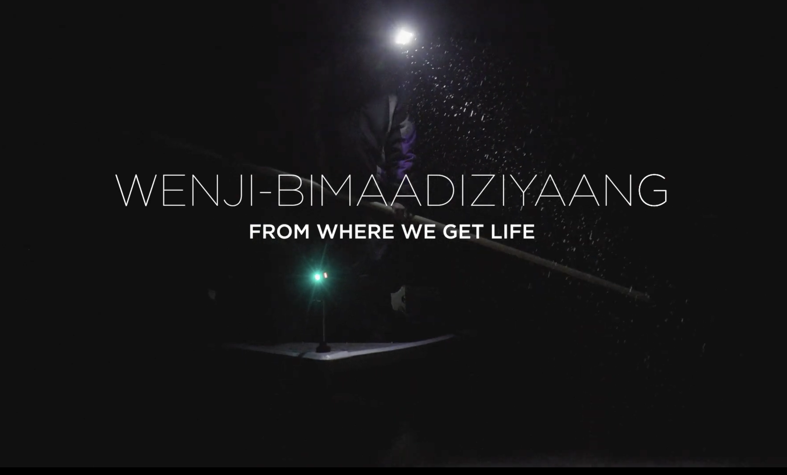
1999
MINNESOTA V MILLE LACS BAND
The U.S. Supreme Court affirmed treaty hunting, fishing, and gathering rights in Minnesota 1837 Ceded Territory. This decision served to end all debate, begun over twenty years ago when the LCO case was filed in 1974, that the Bands’ treaty rights exist. The Court ruled in favor of the Bands on all three issues, finding that the 1850 Removal Order, Minnesota’s statehood status, and that the 1855 Treaty with Mille Lacs did not terminate the Bands’ treaty rights.
Notes:
https://www.youtube.com/watch?v=yDC_-U7wW40&list=PLFXNmBtWd9iF2ppvNFJ5_WNRmiyFDK5Nu&index=8

Slide 42
2007
MICHIGAN CONSENT DECREE
In 2003, the State of Michigan asked the federal court to decide whether inland treaty rights continue to exist, and if they do, where they can be exercised.
The five 1836 Treaty tribes along with the U.S. agreed that inland treaty rights needed to be resolved.
In late summer 2005, the parties explored the willingness of everyone to resolve all the issues related to 1836 Treaty inland rights by negotiation, rather than litigation.
Their efforts were finalized in a Consent Decree in 2007. The decree contains acknowledgement by the State of Michigan of the permanent recognition of the tribes’ “Inland Article 13 Rights.”

Slide 43


2020
The treaty of 1842 or commonly known as the “Copper Treaty” ceded millions of acres of land to the U.S. in exchange for rights to hunt, fish, and gather within the Ceded Territory. Within this territory is Buffalo Reef, a natural cobble feature in Lake Superior, located on the eastern edge of the Keweenaw Peninsula in the upper peninsula of Michigan.
Buffalo Reef has historically maintained invaluable spawning habitat for fish species such as Lake trout and lake whitefish, but now is threatened by migrating stamp sands, produced by harmful mining activities beginning in the late 1800’s. Tribal, State, Federal, and academic partnerships combine efforts to mitigate damages and ultimately restore Buffalo Reef as the ecological resource that has sustained both tribal and non—tribal communities for generations.
BUFFALO REEF CLEANUP AND RESTORATION
Notes:
https://www.youtube.com/watch?v=VpcFiMx94Zk&list=PLFXNmBtWd9iF2ppvNFJ5_WNRmiyFDK5Nu&index=7

Slide 44
Chi miigwech!
CREDITS
Finn Ryan Scott Pauli
Dylan Jennings
Jennie Kappenman David O’Connor
Dan Soulier

